Slide 1
Ultralight Ticketing Application
Group 19
Ahmed Beder
Mariana Farias
Shamim Biswas

Slide 2
Overview
Basic Features:
Buy a ticket with 5 valid rides.
Set expiration date of a card to midnight of the day after the first use.
Top off tickets with extra rides without losing already available rides
Security Features:
Tampering prevention for values on the card, like valid rides and expiration date.
Tearing protection.
Key Diversification.

Slide 3
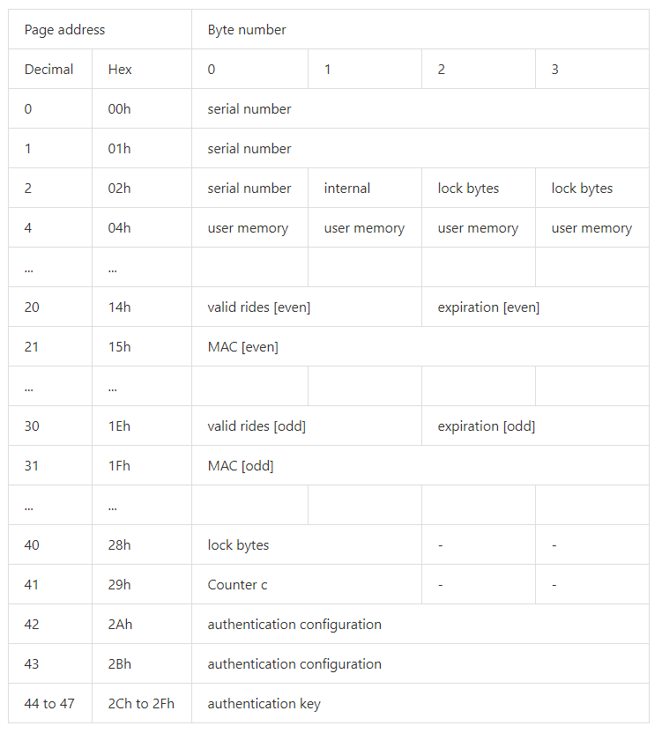
Card Data Structure
Notes:
Counter c: We make use of the Ultralight 16-bit counter to account for the number of operations already executed on the card. Whenever we conclude an issue or use operation, we increment the counter. Using this variable, in tandem with an even/odd pages for reading and writing schemes works as a control technique in case of tearing.
Valid Rides: Keeps track of the number of rides left in the card.
Expiration: The number of days from the UNIX Epoch.
Mac(Valid Rides + expiration + c): A Mac of all values present in the card truncated to fit one page of memory. This variable guarantees the integrity of the data present on the card.

Slide 4
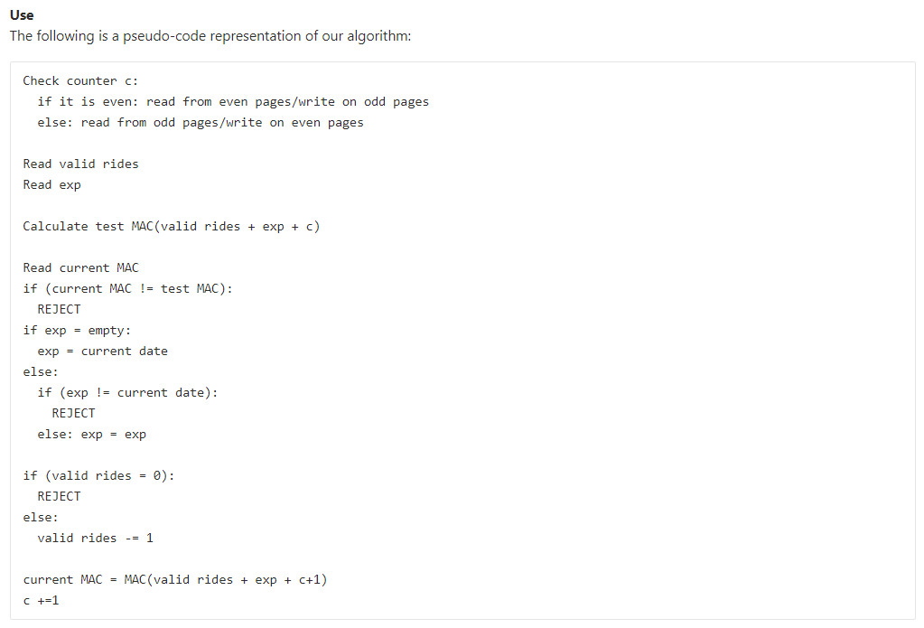
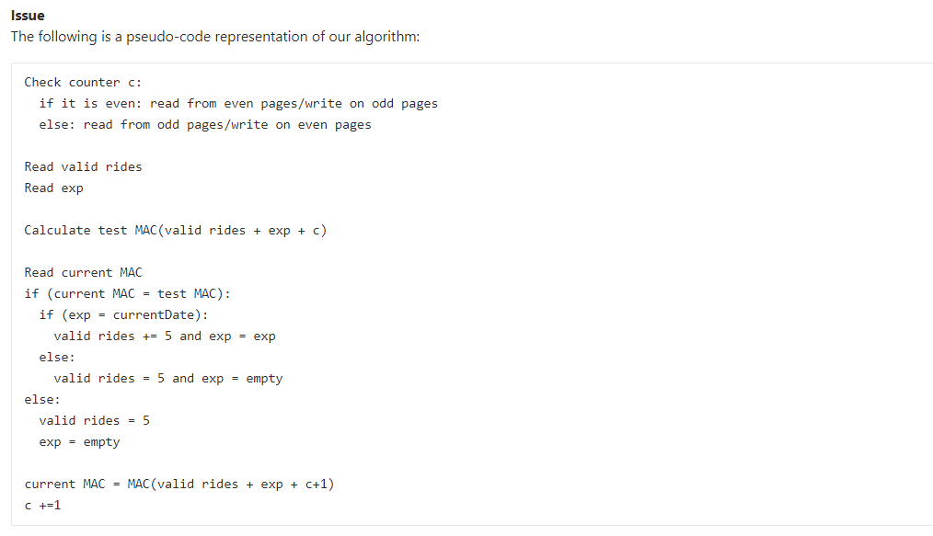
Implementation

Slide 5
Key Management
Authentication Key: Changed and stored on the card during the issuing the card for the first time.
MAC Key: We use the unique identifiers all cards have on their first 7 bytes concatenated with a secret known to the readers.
To improve this scheme, we can later on switch to storing the keys on a server and fetching only the authentication keys and reader secret of that specific card.

Slide 6
Reliability and deployablity
Notes:
Reliabiltiy: When designing the the ticketing application, we wanted to guarantee that the user will have seamless interaction with the ticket to use his rides. We insured that there will be no errors due to tearing by using even/odd writing schemes and that there are as few writing transactions as possible so that the transaction is seamless.Furthermore, in the intial design all the required keys are present on the reader so there will be no failures or slowness due to network errors.This can be mitigated however, even when using an online server for keys by implementing offline authentication with limited number of times.
Deployability: The reader consists of a simple android application so it can easily be deployed to any phone.

Slide 7
Security Concerns
Rollback Prevention
Man In the Middle Prevention
System Failure due to Leaked Key
Tearing Protection
Notes:
Rollback Prevention – (MAC) An attacker may attempt to write back old data to the same card, including old MACs that would enable the attacker to restore tickets after using it. This is prevented in the architecture by including the counter in the MAC stored. Since the counter can never be decremented the MAC check should not pass unless the card has not been tampered with.
Man In the Middle Prevention - An attacker may send commands to modify the card contents after authentication has been established .This is prevented in the architecture by including a MAC for the rides and expiration date values and storing that on the card.
System Failure due to Leaked Key - This is guaranteed by making secret key for each card, which includes a master key and that card's UUID.
Tearing Protection - Tearing can happen if the user pulls the card away from the reader during writing, in particular when there are multiple page writing operation. This is prevented in the architecture by using the counter as a transaction control value and keeping two sets of the data, even and odd. When the counter is even, the reader will read from pages 20, 21 and write to 30,31 and when the counter is odd, the reader will read from pages 30,31 and write to 20,21. Only when all writing operations have been commited will the counter be updated.

Slide 8
Known Weaknesses
Pass-back
No On-the-fly modifications to data structures
Notes:
Pass-back: An attacker can use the card, and pass back to another person to also use the same card. Even though the valid rides is decremented each time, this would allow multiple people to use only one card. This problem could be mitigated by adding a timestamp when using the ticket and blocking of the use for the ticket for a reasonable time with respect to that timestamp.
No On-the-fly modifications to data structures: This can be mitigated to some extent by adding a version tag to the card and checking that tag to identify which protocol to use. This depends on the updating of the data structure as some fields like the counter may not be suitable to use for a different function.

